Slide 1
Implementation of Micro-Chip for IoT applications
Done by,
ARUMUGAM Marimuthu 60303 CHINNIAH vinodhkumar 60307 JOSEPH Jojo 60299 OKORO Oghenerume Cyril 60481 SENGUTTUVAN Dhinesh Kumar 11000 VENKATESAN Shalini- 60301

Slide 2
OBJECTIVE
Implement and simulate a SoC using a BT connection integrated for a wireless communication with a terminal and CMOS based sensors to interact with its environment.
This SoC will implemented using the platform MicroWind for a CMOS technology of 130nm.

Slide 3
Scale Down Benefits
120 nm Technology scale down
Gate dielectric – SiO2
Kgates – 240 mm2
Effective gate length – 70nm
Smaller
Faster
Less Power Consumption
Cheaper (If fabricates million)

Slide 4
Microwind Software
User-friendly design tool
Simulate and design an integrated circuit at physical description level.
Innovative CMOS design tool for educational market.
It works in Lambda units (λ).
DRC Checks.
500 design rules for 130nm

Slide 5
Very Simple Microprocessor Architecture
The goal of this project is to build a 8 bit processor at logic level
VSM Architecture includes:
1) Microinstruction 10) Bluetooth
2) Program Counter 11) Temperature Sensor
3) SRAM 12) ADC
4) Accumulator A 13) DAC
5) ALU 14) Instruction register
6) Accumulator B
7) Input register
8) Output Register

Slide 6
VSM Architecture
Internal bus
VSM Architecture
Clock
Microinstruction
Accumulator A
Clear
ALU
Enable signal
Program Counter
Accumulator B
Program memory
Input Register
ADC
Temperature sensor
Instruction Register
Output Register
DAC
Bluetooth

Slide 7
Enable Signal
Take the control of the bus.
Enable A – Authorize A to take control of the bus.
EnableAlu – Put the result of ALU on the bus.
EnableInstr – Put the data part of the instruction on the bus.
EnableIn – Transfer the content of external input on the bus.

Slide 8
Four times phases
Execution of one instruction is based on four times phases.
Phase | Name | Description
Phase 1 | Address state | The content of the desired memory location is loaded into the instruction register.
Phase 2 | Increment state | The program counter address is incremented. The instruction register provides the microinstruction decoder with the instruction.
Phase 3 | Execute step 1 | Depending on the instruction, the microprocessor performs the first step of the execution phase.
Phase 4 | Execute step 2 | The microprocessor performs the second step of the execution phase.

Slide 9
Phase 1
Internal bus
VSM Architecture
Phase 1
Microinstruction
Accumulator A
ALU
ReadMem
Program Counter
Accumulator B
Program memory
Input Register
ADC
Temperature sensor
Instruction Register
Output Register
DAC
Bluetooth
LoadInstr

Slide 10
Phase 2
Internal bus
VSM Architecture
Phase 2
Microinstruction
Accumulator A
Feed with the instr
ALU
ProgCount
Program Counter
Accumulator B
Program memory
Input Register
ADC
Temperature sensor
Instruction Register
Output Register
DAC
Bluetooth
EnableInstr

Slide 11
Load Instruction(LDA=00000101)
Internal bus
Phase 3
Phase 3
Microinstruction
Accumulator A
ALU
Program Counter
Accumulator B
LoadB
Program memory
Input Register
ADC
Temperature sensor
Instruction Register
Output Register
DAC
Bluetooth
EnableInstr

Slide 12
Get Input (IN=00000100)
Internal bus
VSM Architecture
Phase 3
Microinstruction
Accumulator A
LoadA
ALU
Program Counter
Accumulator B
EnableIn
Program memory
Input Register
ADC
Temperature sensor
Instruction Register
Output Register
DAC
Bluetooth

Slide 13
Subtraction(SUB=00000010)
Internal bus
Phase 4
Phase 4
Microinstruction
Accumulator A
LoadA
ALU
EnableAlu
Sub=0
Program Counter
Accumulator B
Program memory
Input Register
ADC
Temperature sensor
Instruction Register
Output Register
DAC
Bluetooth

Slide 14
Give Output (OUT=00000011)
Internal bus
Phase 3
Phase 3
Microinstruction
Accumulator A
EnableA
ALU
Program Counter
Accumulator B
Program memory
Input Register
ADC
Temperature sensor
Instruction Register
Output Register
DAC
Bluetooth

Slide 15
D-register
One of the most widely used cells in integrated circuit design.
Uses edge-triggered latches.
Information flows from input D to the Output Q only at a rise edge clock.
Circuit is based on inverters and pass transistors.
It is constructed from two memory loop circuits in series.
The cell structure includes a master memory cell(left) and slave memory cell (right).

Slide 16
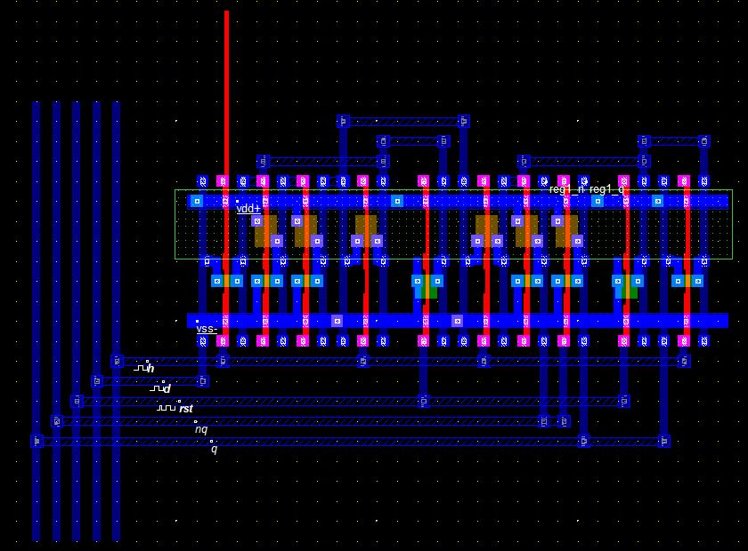
Layout of D-register

Slide 17
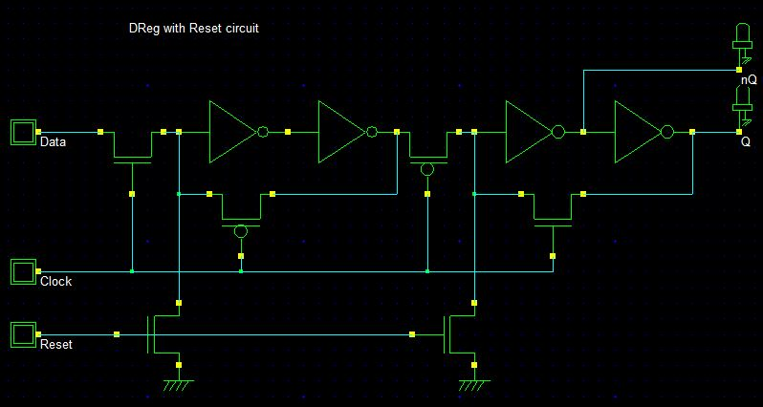
Schematic Diagram

Slide 18
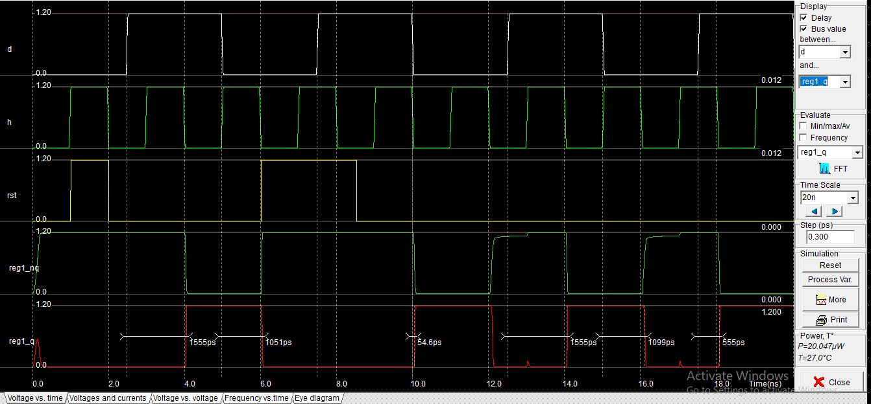
Simulation result
d
clk
rst
~q
q

Slide 19
Microinstruction
Heart of the microprocessor.
Controls the Enable and Latch signals.
Instruction code and Phase information is the input of microinstruction.
Four input AND gate used to serve as a Instruction decoder.
Stores the sequence for the last two phase for each instruction.

Slide 20
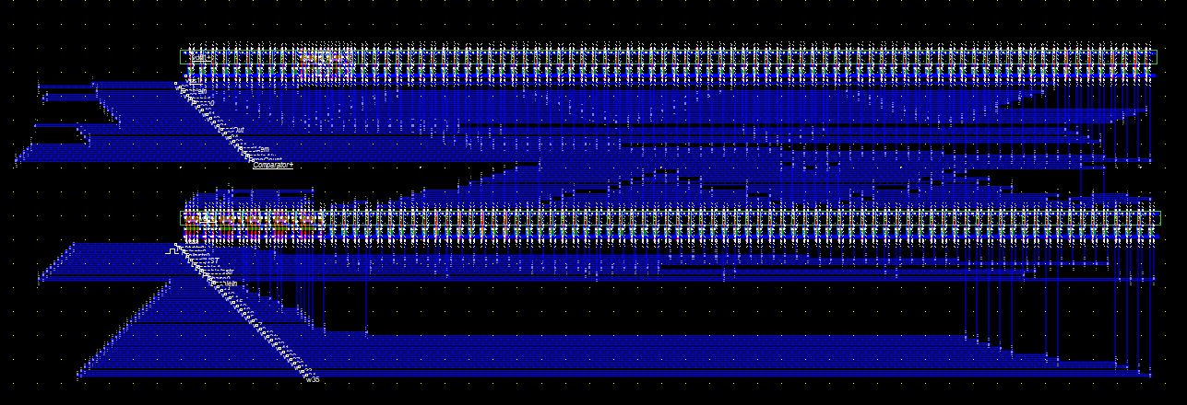
Layout of Microinstruction

Slide 21
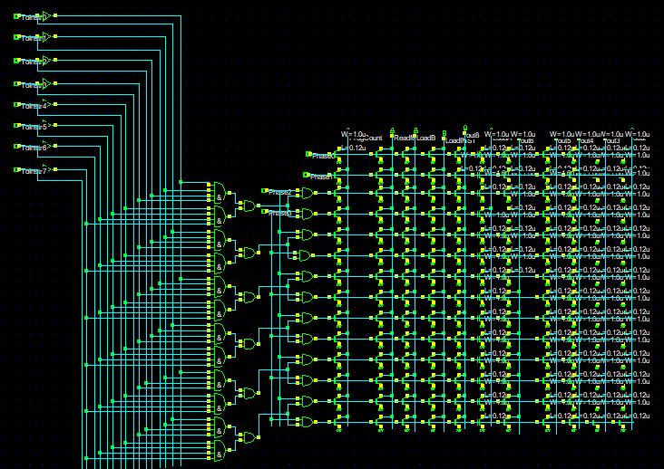
Schematic Diagram

Slide 22
Program Counter
Program Counter is a 8-bit register.
Monitor the address of the active instruction.
Counts from 00000000 to 11111111.
Counter set to 00000000 so that microprocessor starts by the first instruction.
Chain edge-sensitive D-registers.
Circuit is very simple and works Asynchronously.

Slide 23
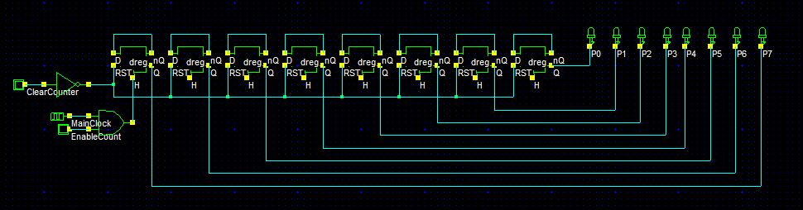
Schematic Diagram
Program counter

Slide 24
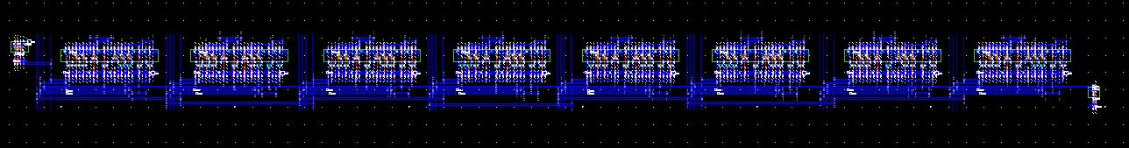
Layout of Program Counter

Slide 25
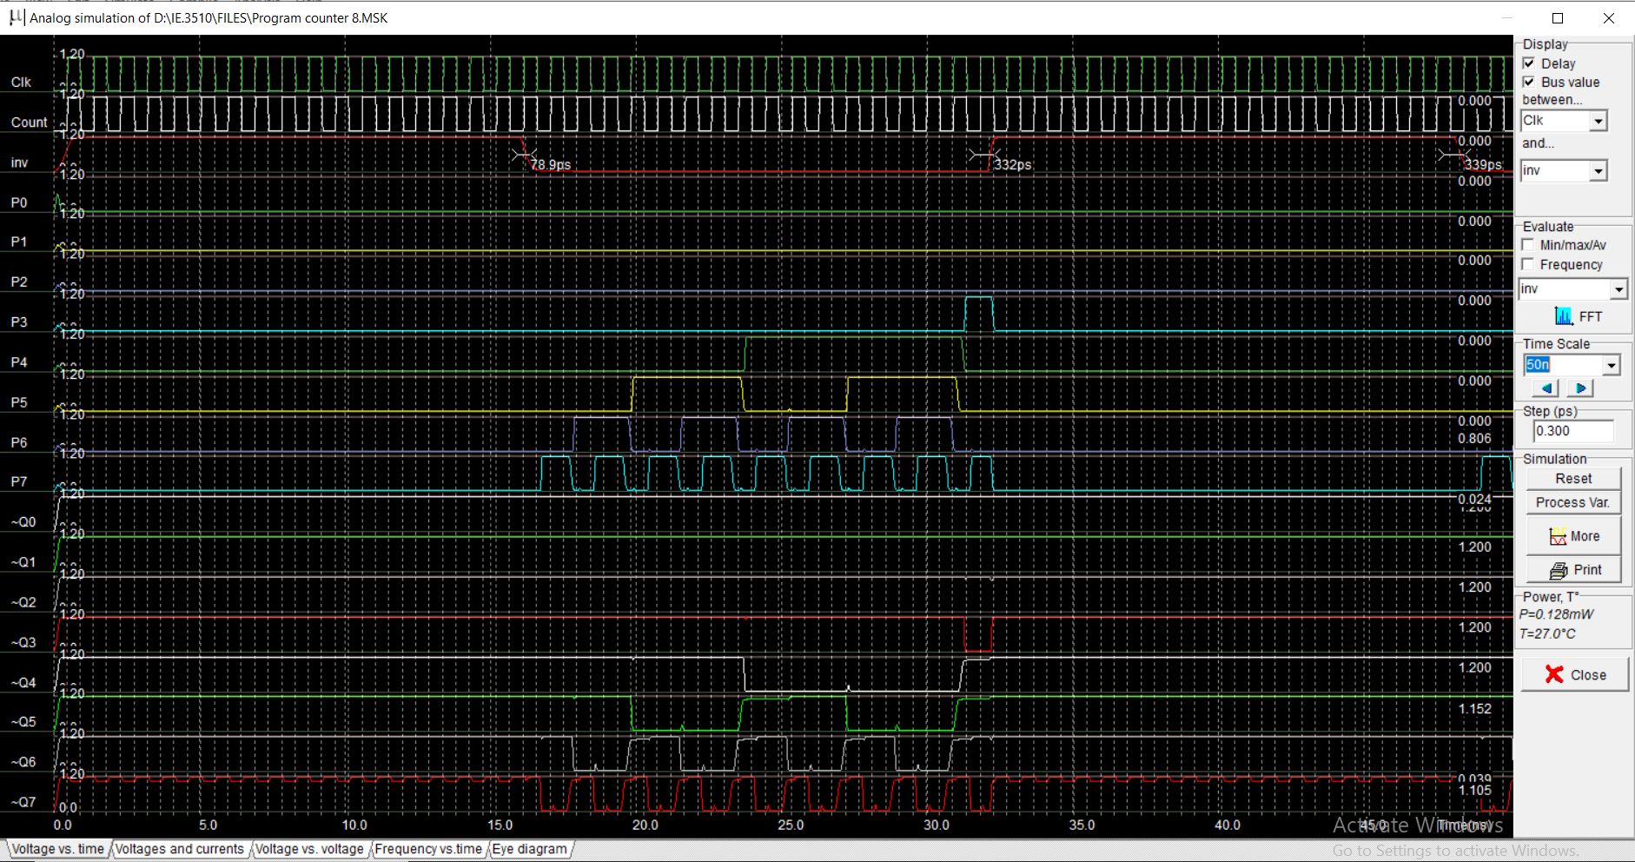
Simulation result
Clk
Cnt
Inv
Po
P1
P2
P3
P4
P5
P6
P7
Q0
Q1
Q2
Q3Q4
Q5
Q6
Q7

Slide 26
Program Memory - SRAM
Program memory contain up to 16 bytes.
Store instructions for execution.
Each instruction coded on 8 bits.

Slide 27
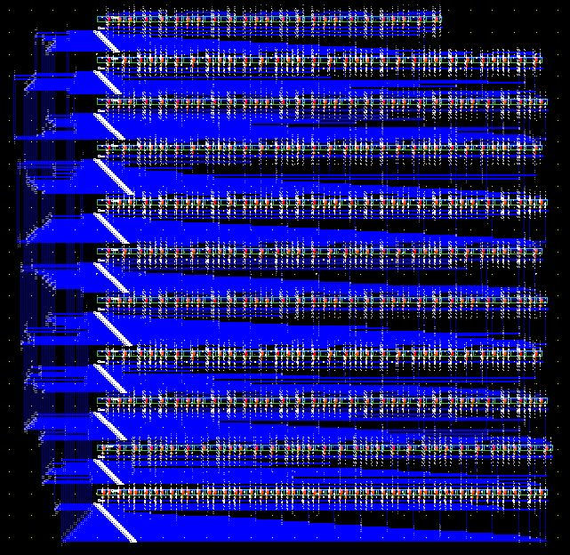
Layout of Program Memory

Slide 28
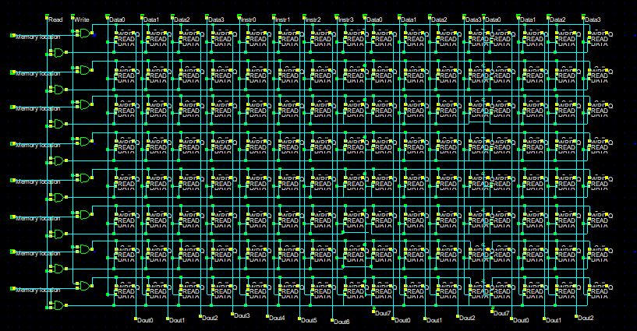
Schematic Diagram

Slide 29
Phase Generator
Based on edge sensitive latch and XOR gates.
It produce the four phase signals phase0 to phase3 at the negative edge of clock
Phase1 - Address state
Phase2 - Increment state
Phase3 - Execute step 1
Phase4 - Execute step 2

Slide 30
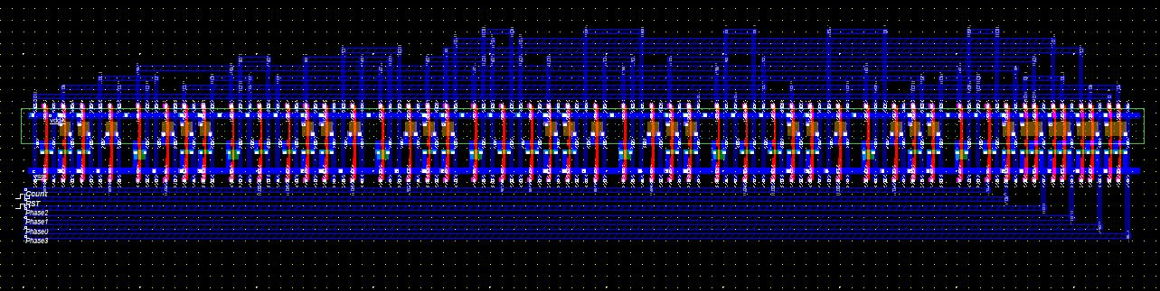
Layout of Phase Generator

Slide 31
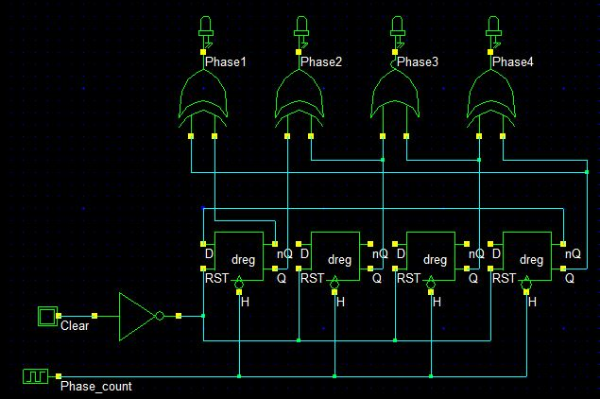
Schematic Diagram

Slide 32
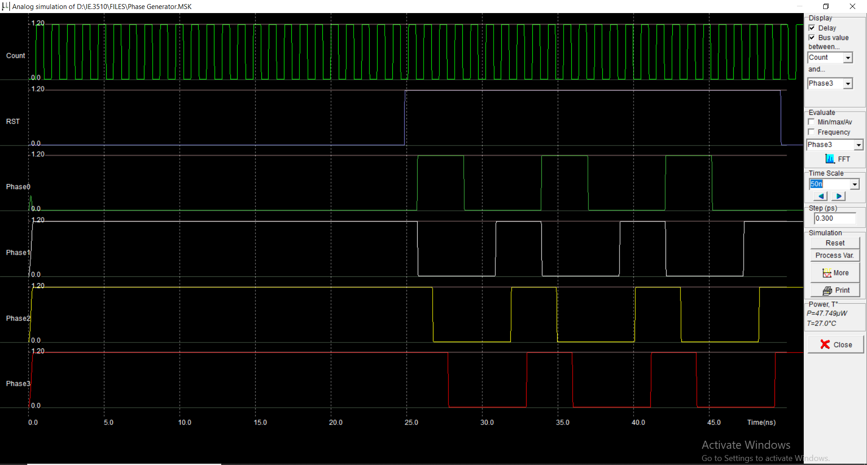
Simulation Result
cnt
rst
phase0
phase1
phase2
phase3

Slide 33
Instruction Register
Stores the content of program memory.
Gives the copy of current instruction and release the main memory.
Instruction code is stored by 8 D-register.
Data is stored by separate 8 D-register.

Slide 34
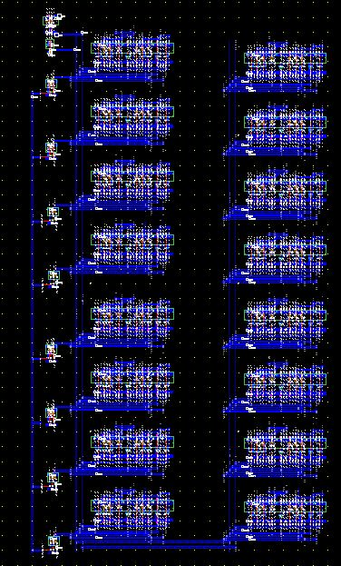
Layout of Instruction Register

Slide 35
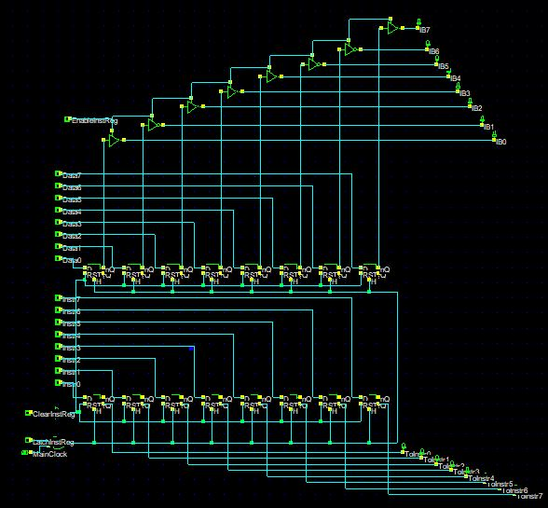
Schematic Diagram

Slide 36
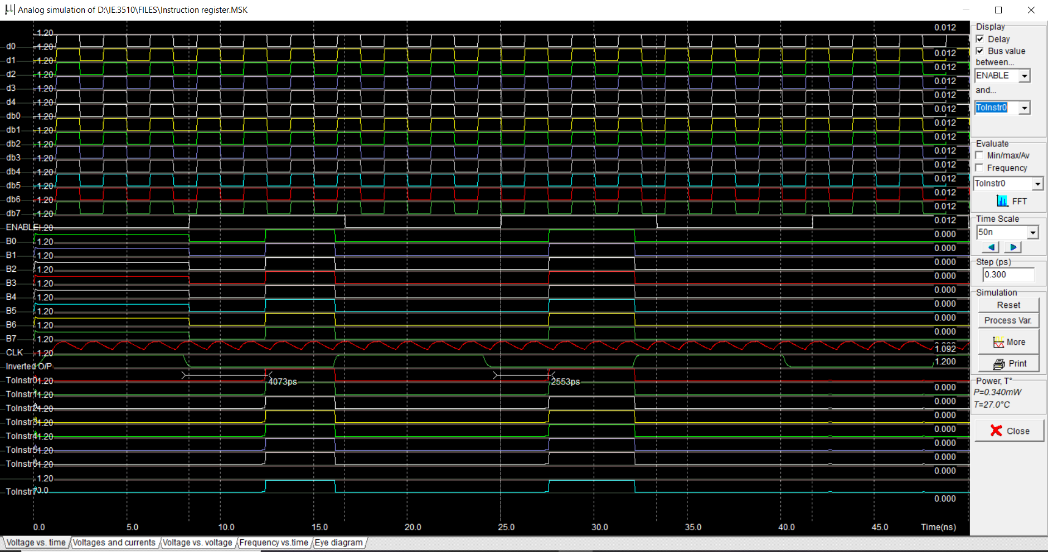
Simulation Result
D0
D1
D2
D3
Db0
Db1
Db2
Db3
Db4
Db5
Db6
Db7
Ebl
B0
B1
B2
B3
B4
B5
B6
B7
Clk
Toins
..
tinst7

Slide 37
ACCUMULATOR A
8-bit register.
Based on 8 edge-sensitive D-registers.
Build with 3 state inverter to access the internal bus.
Stores the intermediate results.
It places the accumulator results on the internal bus when Enable A signal is asserted
The register output is permanently available through AluA0…AluA7 for the operation

Slide 38
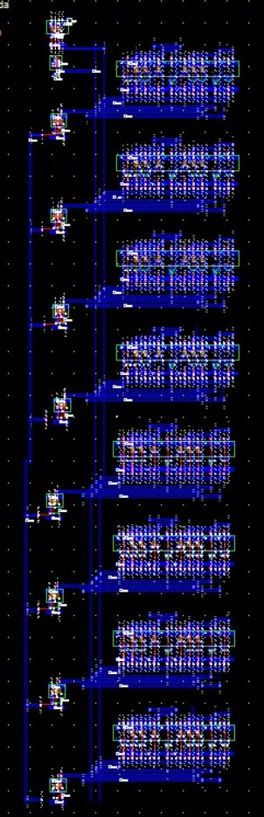
Layout of Accumulator A

Slide 39
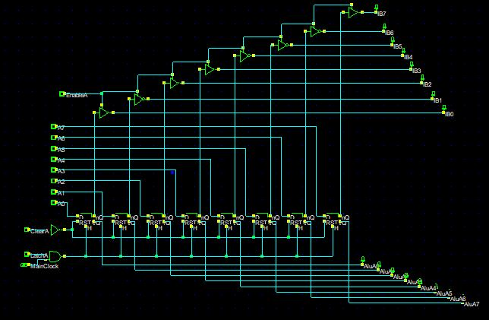
Schematic Diagram

Slide 40
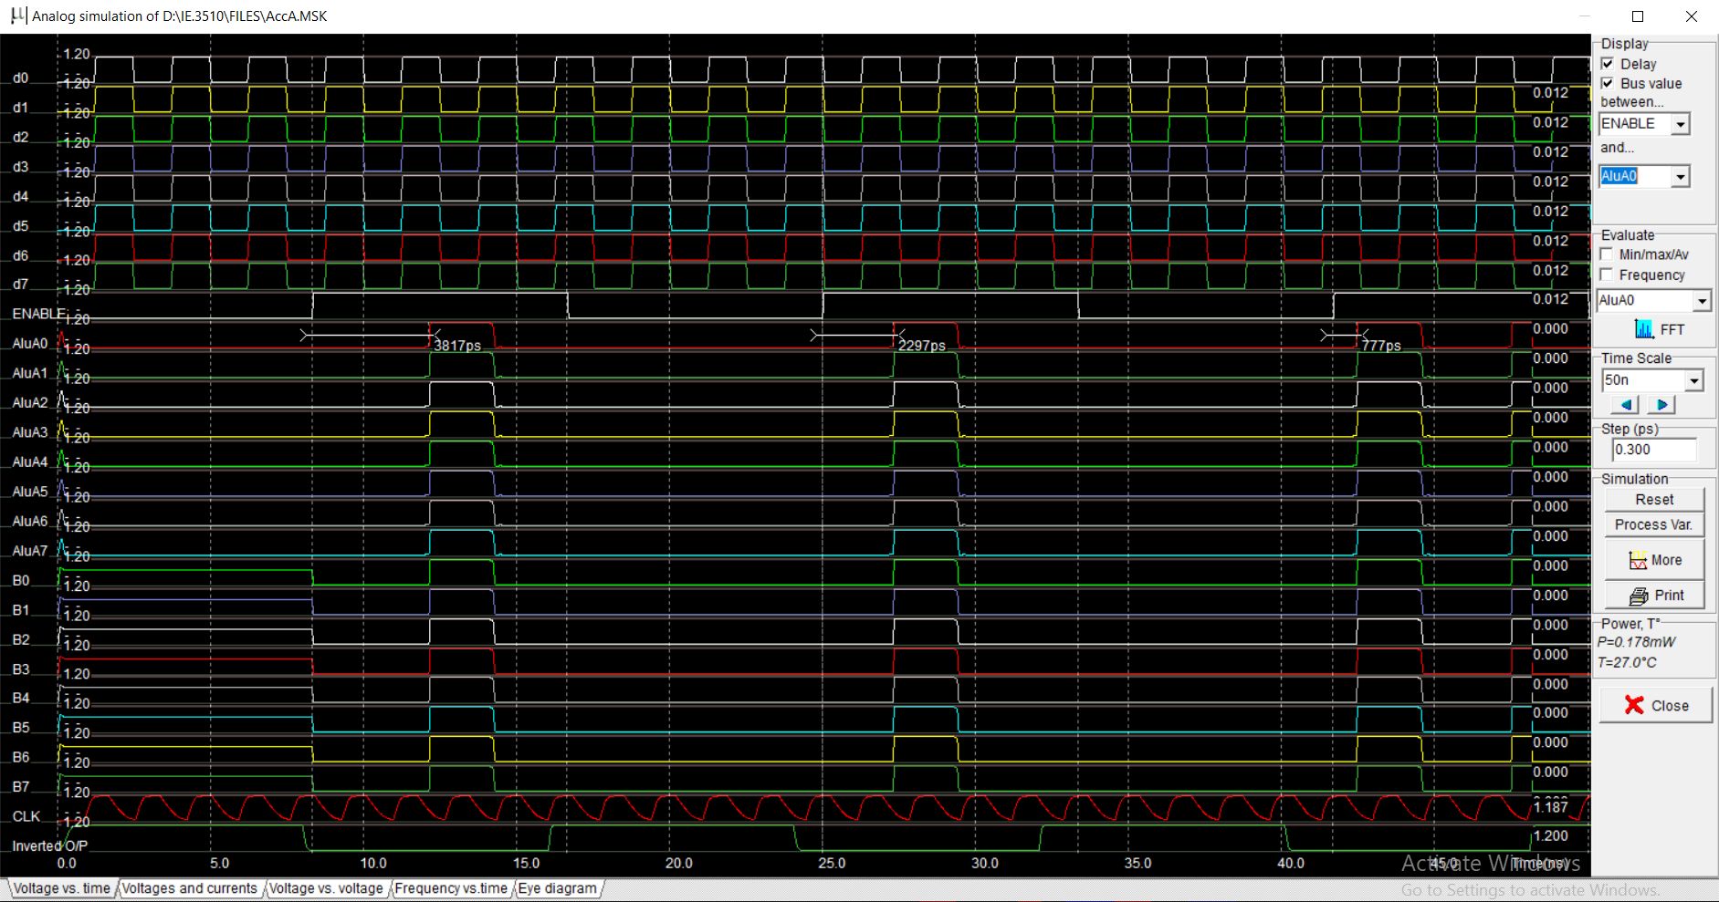
Simulation Result
D0
D1
D2
D3
D4
D5
D6
D7
Ena
Alu0
.
.
Alu7
B0
B1
B2
B3
.
.
.b7
clk

Slide 41
Arithmetic Logic Unit - ALU
Subtraction operation
Requires 8 cascaded full adder
Build two complementary things
A circuit that produces the 1’s complementary of A
A small circuit that set the initial carry to 1.

Slide 42
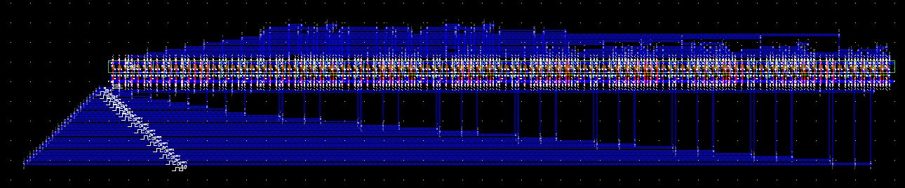
Layout of ALU

Slide 43
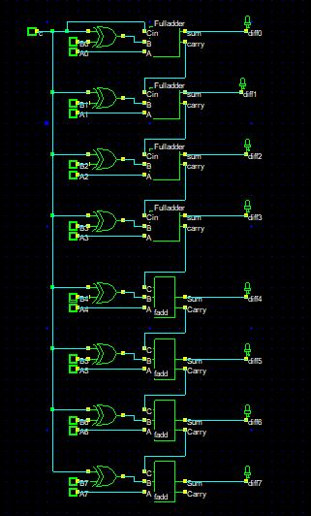
Schematic diagram

Slide 44
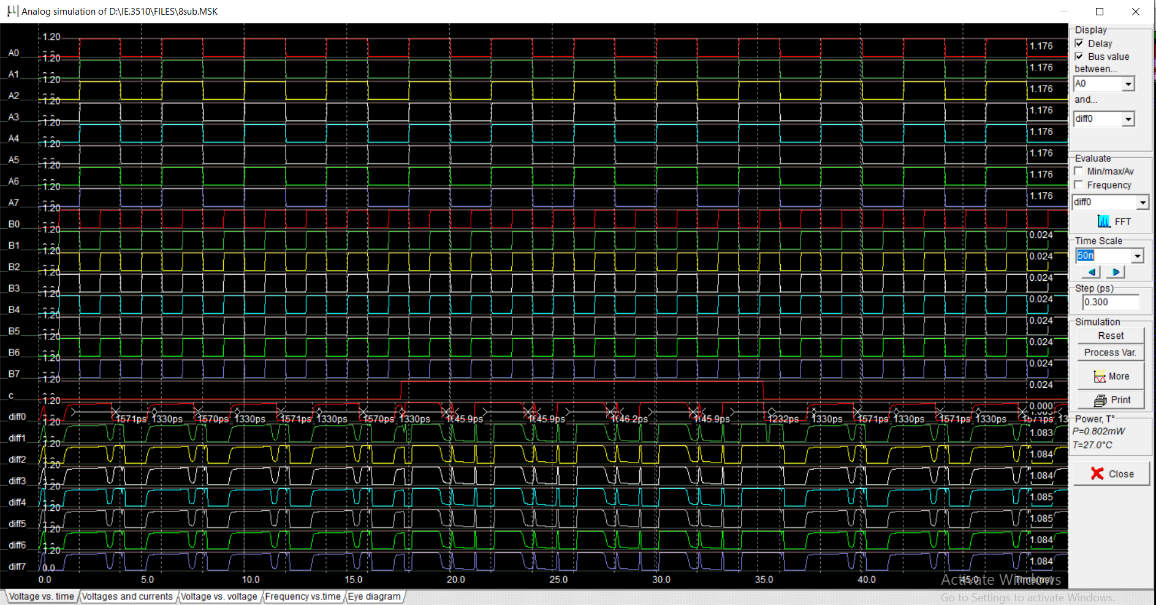
Simulation result
A0
A1
A2
.
.
.
.
A7
B0
B1
.
.
.
B7
C
Alu0
.
.
.
.
.
Alu7

Slide 45
Accumulator B
Similar to Accumulator A
8-bit register
Based on 8 edge-sensitive D-registers.
Mainly used to supply the numbers to execute an operation
The register output is permanently available through AluB0…AluB7 for the operation
Latch A signal used to authorize the transfer of input data.

Slide 46
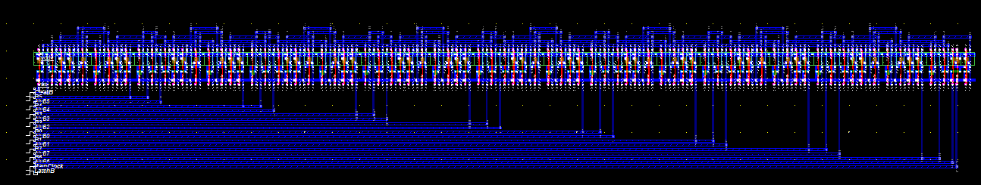
Layout of Accumulator B

Slide 47
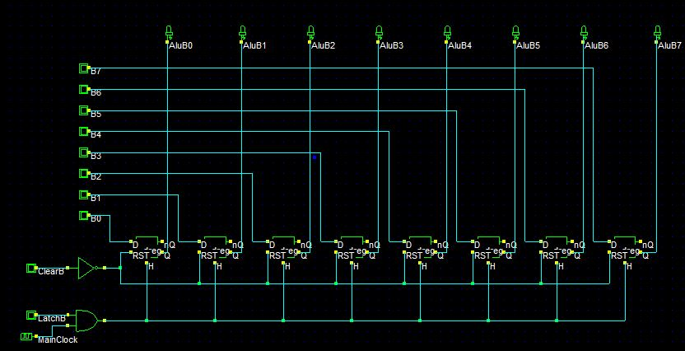
Schematic Diagram

Slide 48
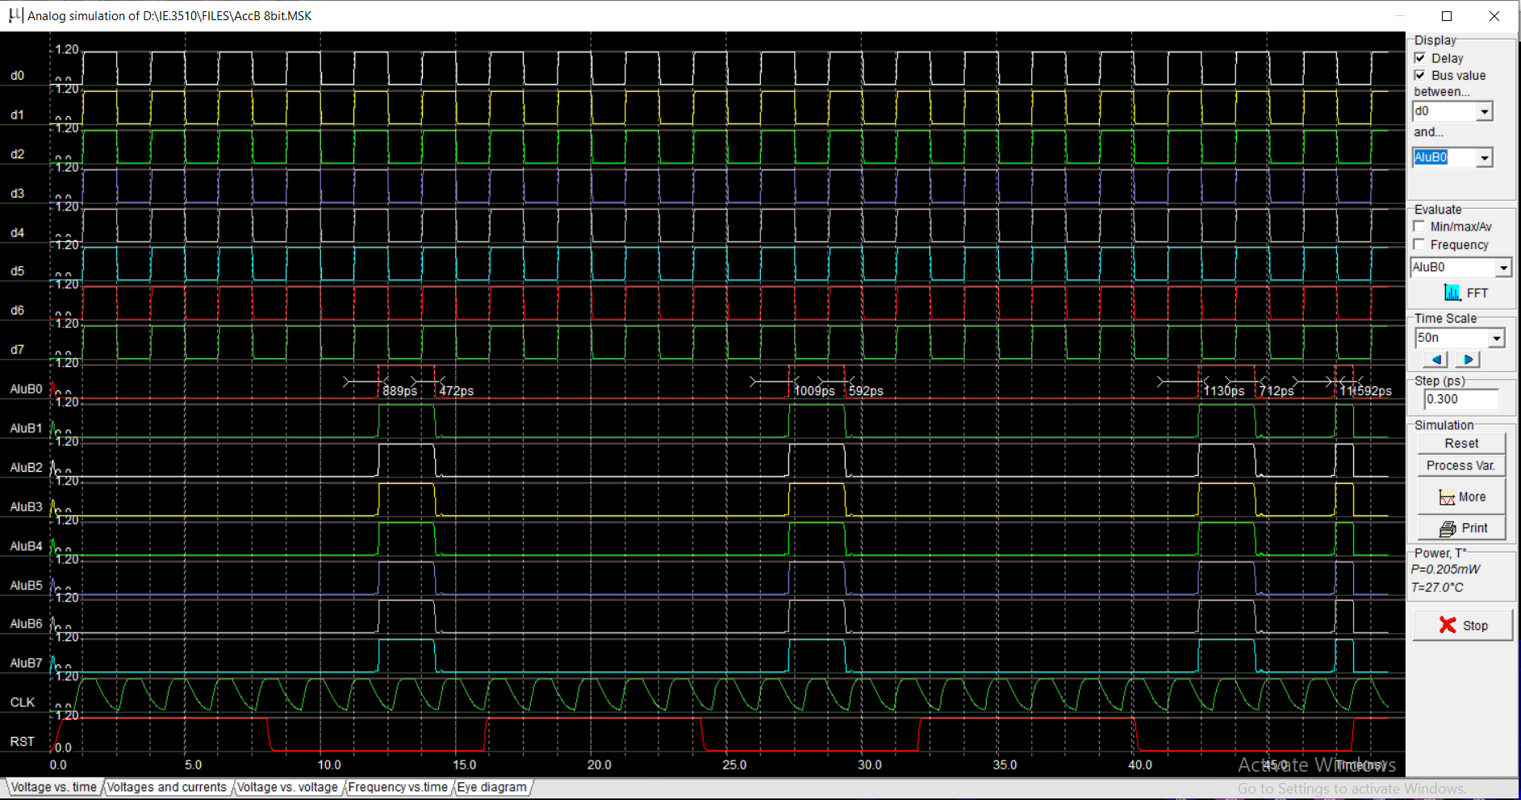
Simulation result
D0
D1
D2
.
.
.
.
D7
Alu0
.
.
.
.
.
Alu7
CLK
RST

Slide 49
Input Register
8-bit register
Simple set of Eight 3-state buffers.
No need of D-registers.
Directly transfer the sensor’s data to Accumulator A.

Slide 50
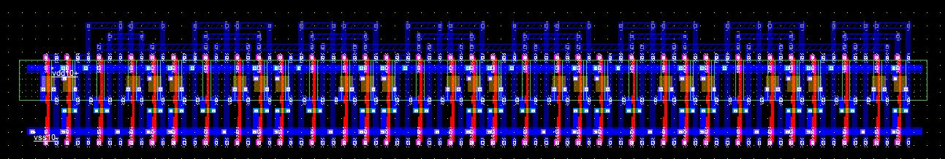
Layout of Input Register

Slide 51
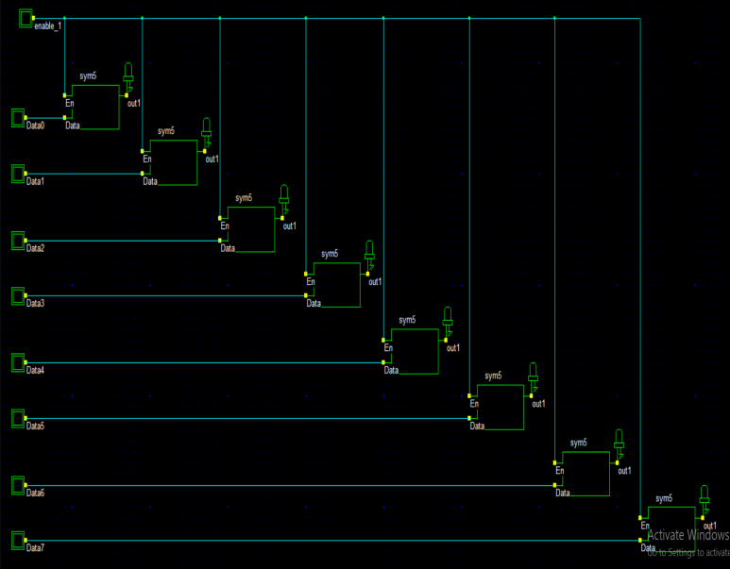
Schematic Diagram

Slide 52
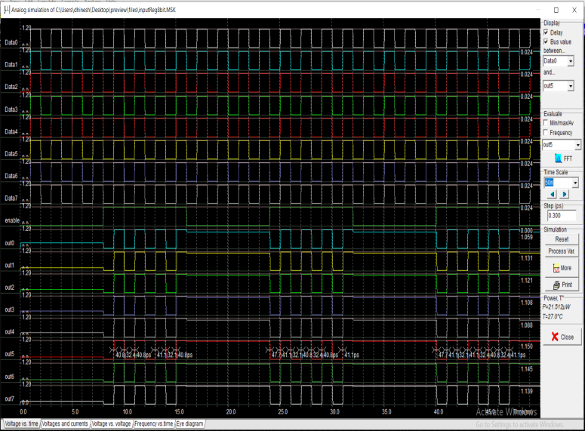
Simulation result
Data0
Data1
Data2
Data3
Data4
Data5
Data6
Data7
Enb
Out0
Out1
Out2
Out3
Out4
Out5
Out6
Out7

Slide 53
Output Register
8-bit register.
Based on 8 D-registers cell.
Instruction performed at end of the program
Stores the output data on a fall edge of clock.
Connected to Bluetooth circuit for transfer the content of internal bus to outside terminal

Slide 54
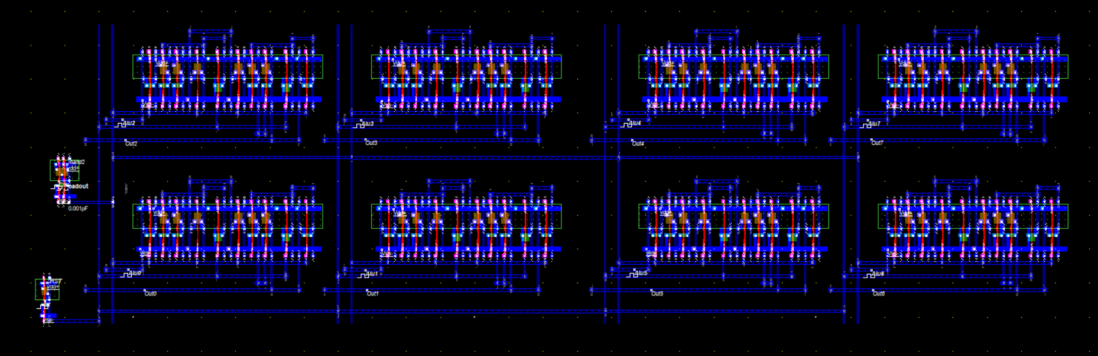
Layout of Output Register

Slide 55
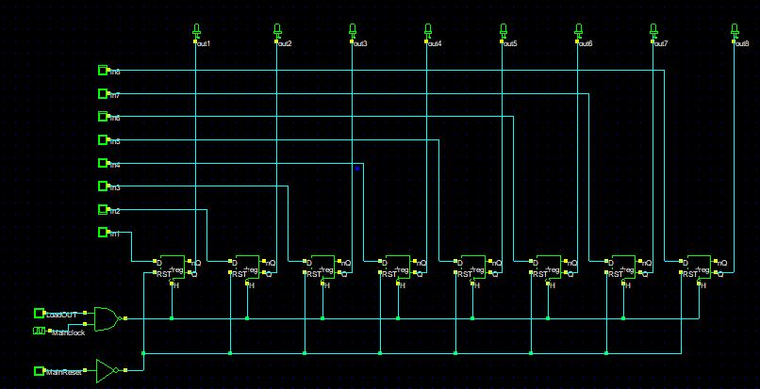
Schematic Diagram

Slide 56
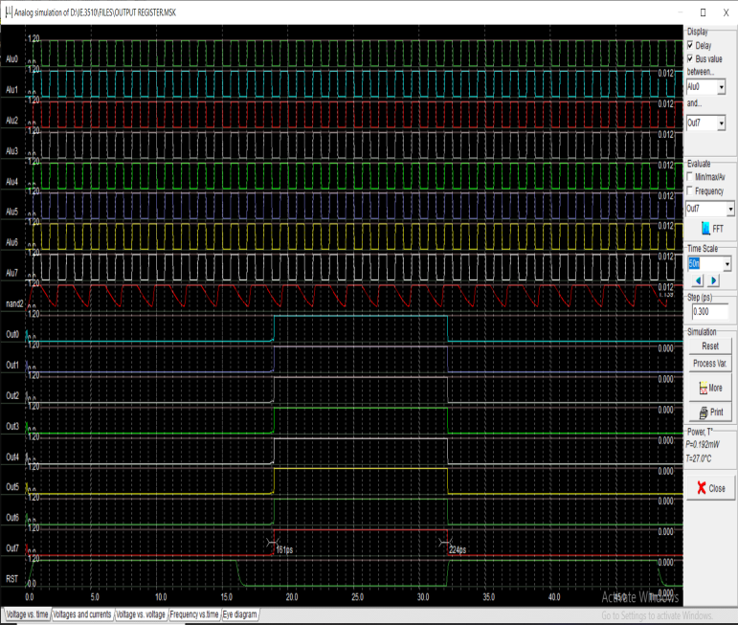
Simulation result
In1
In2
In3
In4
In5
In6
In7
In8
Lout
CLK
Out1
Out2
Out3
Out4
Out5
Out6
Out7
Out8

Slide 57
ADC
8 bit ADC converts an analog value into 8 bit digital value.
Used resister ladder generates voltage reference used by voltage comparator
Open loop amplifier used as a voltage comparator.
Flash converter used for very high sampling rates.
Thermometer code into binary code.

Slide 58
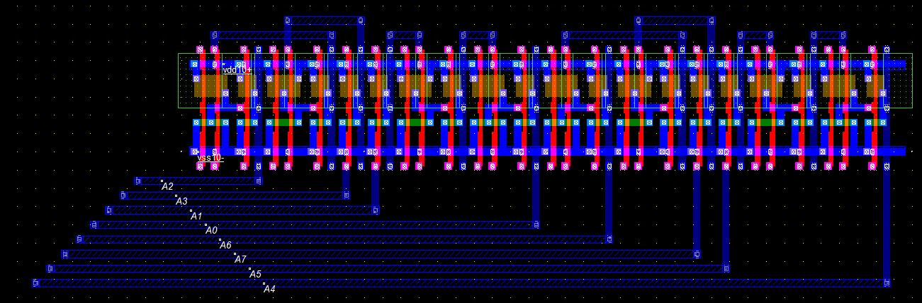
Layout of ADC

Slide 59
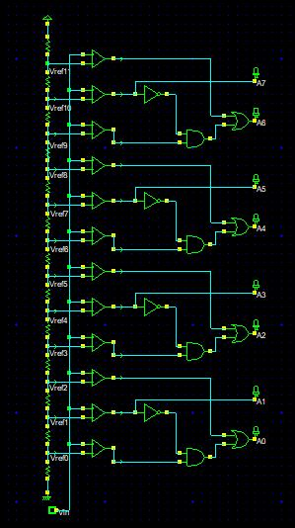
Schematic diagram

Slide 60
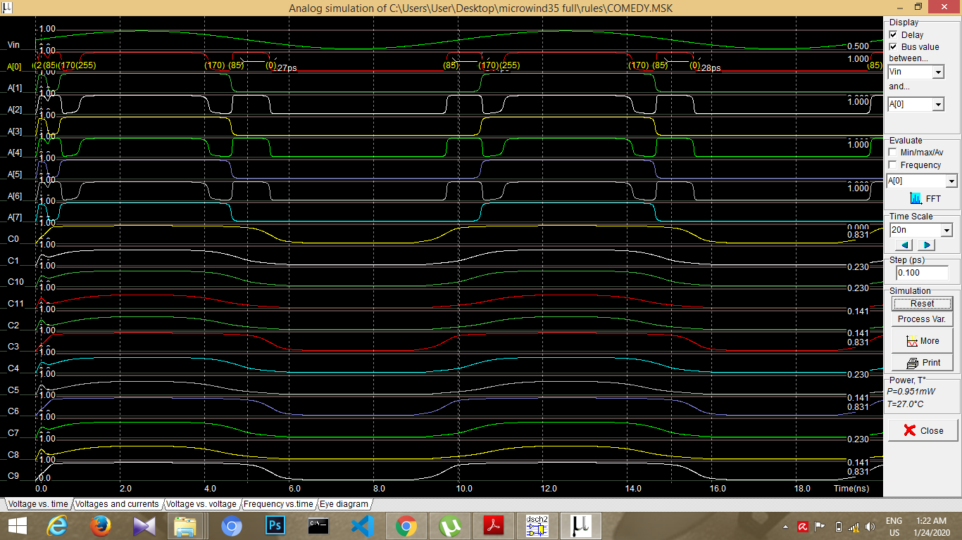
Simulation result
Vin
ao
a1
a2
a3
a4
a5
a6
a7
c0
c1
c2
c3.
.
.
C11

Slide 61
DAC
Digital to Analog conversion
Used R-2R Ladder for simple and inexpensive way to perform DA conversion.
The digital data are entered through the 8 lines (D0 to D7) which is to be converted to an equivalent analog voltage (Vout) by the mean of the R/2R resistor network.

Slide 62
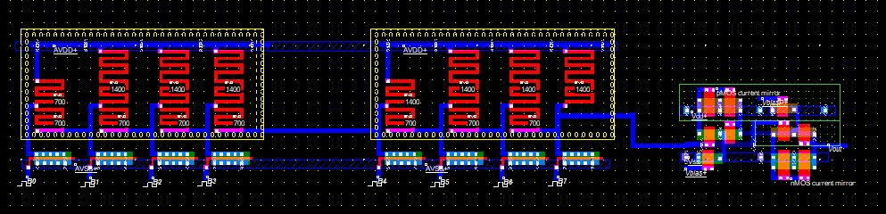
Layout of DAC

Slide 63
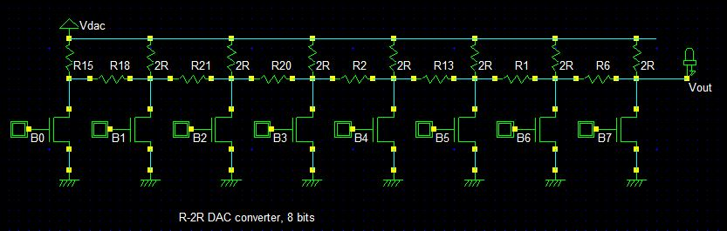
Schematic Diagram

Slide 64
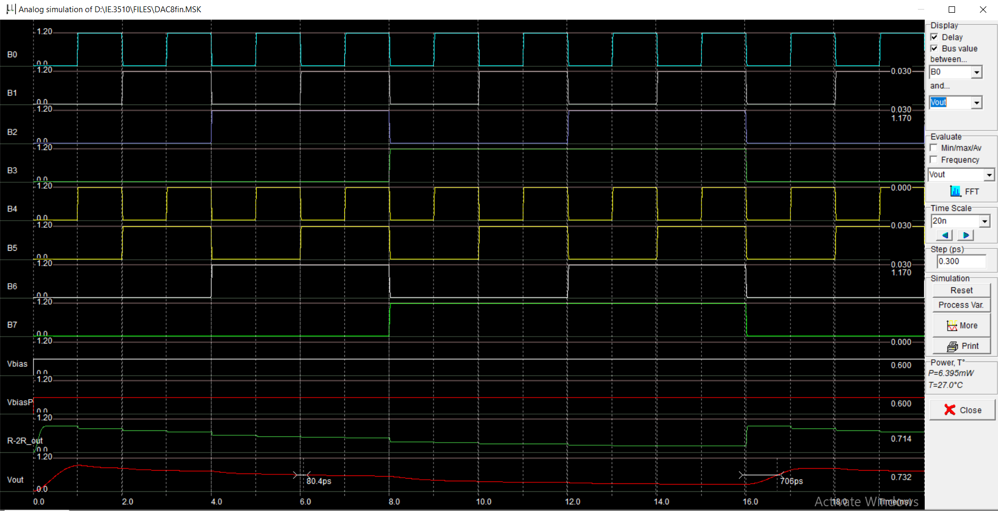
Simulation result
Do
D1
D2
D3
D4
D5
D6
D7
Vbias
Vbias
R-2R
Vout

Slide 65
Temperature Sensor
PN Diode serves as a temperature sensor.
Diode voltage serves as a measuring of the temperature.
pMOS device serves as a load
-40 °C to 120 °C with a step of 20 °C.

Slide 66
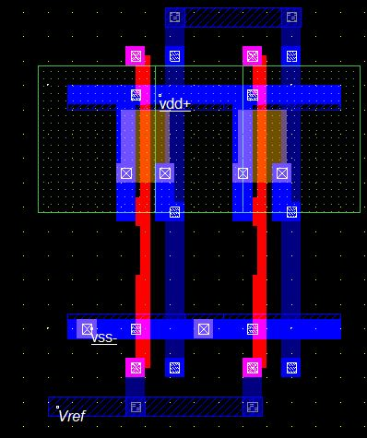
Layout of Temperature sensor

Slide 67
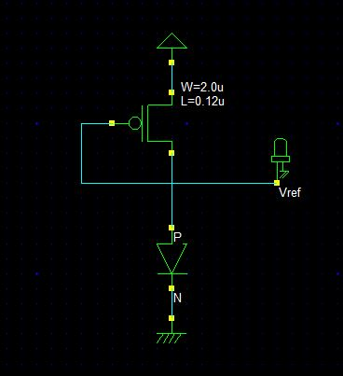
Schematic Diagram

Slide 68
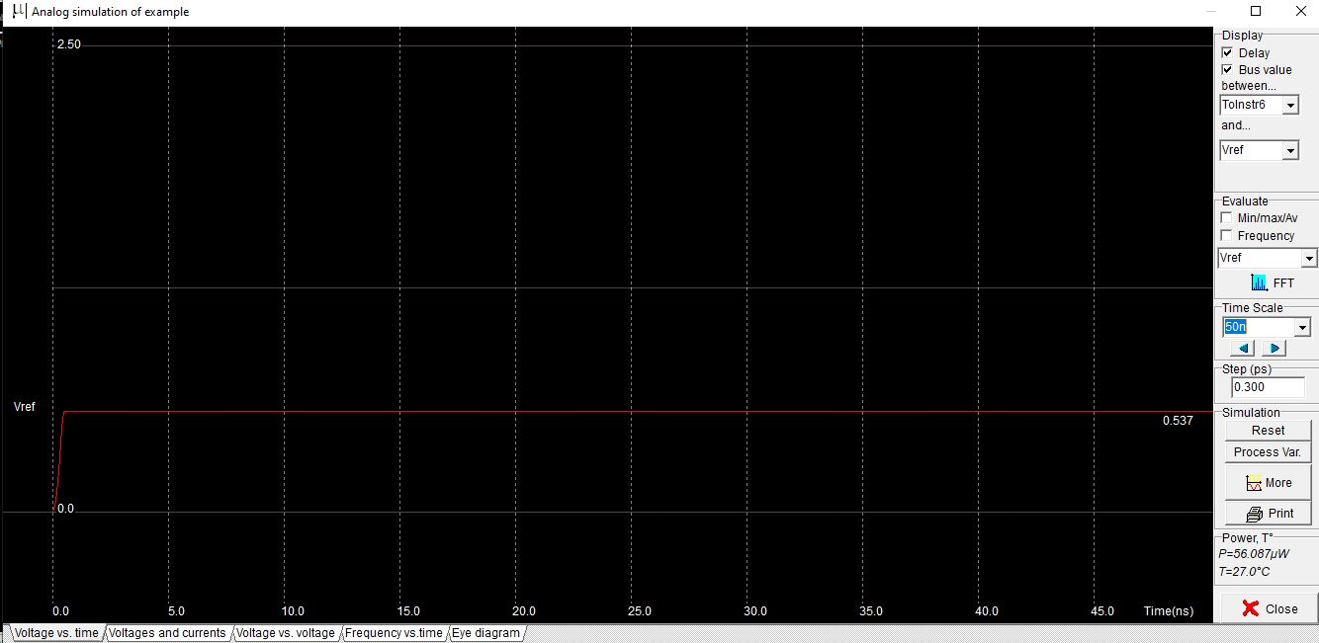
Simulation result

Slide 69
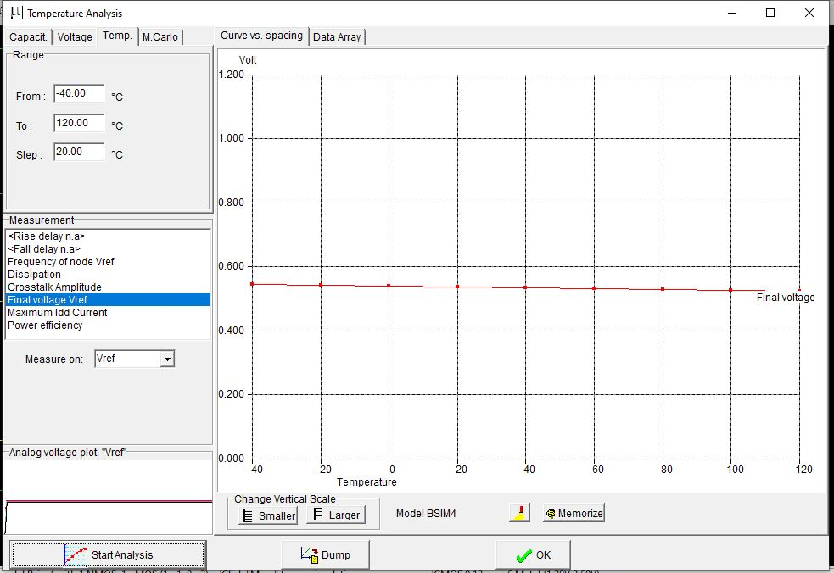
Temperature Analysis

Slide 70
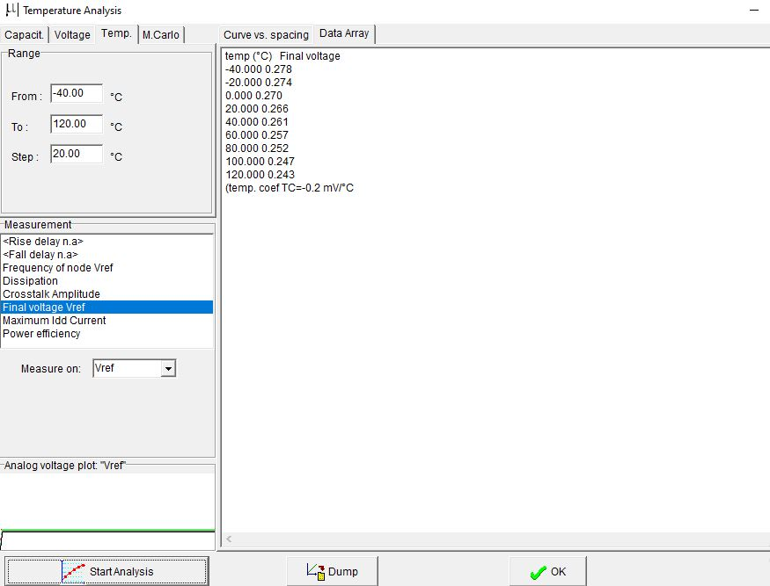
Data Array Final value Vref added to the data array. Vref decreases linearly with temperature with Slope of around –1.2 mV/°C.

Slide 71
Radio Frequency - Bluetooth
Frequency – 2.4 GHz.
Data rate – 0.72 - 10Mb/s
Output power – 100mW

Slide 72
Block Diagram
Radio Frequency
Voltage Controlled Oscillator
Power Amplifier

Slide 73
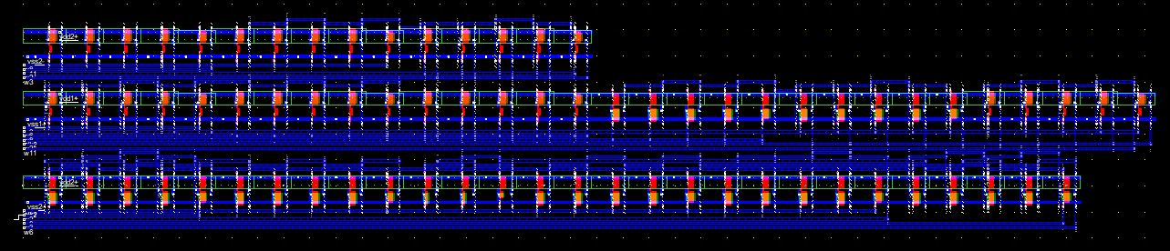
Layout of Radio frequency circuit

Slide 74
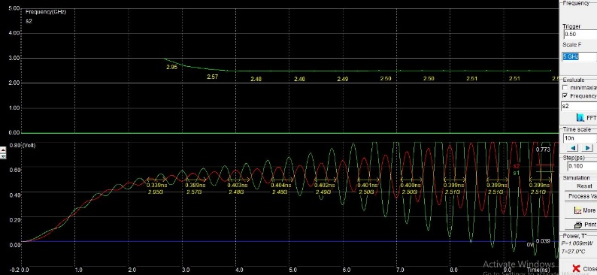
Simulation result

Slide 75
References:
http://srv-wwwperso.insa-toulouse.fr/~sicard/microwind/students.html

Slide 76
THANKS TO OUR PROFESSOR
Dr.Lionel Trojman, PhD

Slide 77
Thanks to our guide

Slide 78
THANK YOU

